Slide 1
Resolving Assessment Issues in HE: Learning from innovation in programme-focused assessment
Prof Chris Rust
Prof Peter Hartley
Ruth Whitfield

Slide 2
Licensed under a Creative Commons Attribution-NonCommercial-ShareAlike 3.0 Unported License

Slide 3
About the PASS project
NTFS group project over 3 years:
  One year of development and investigation and two years of implementation.
Consortium led by Bradford included 2 CETLs – ASKe & AfL:
  University of Bradford.
  University of Exeter.
  Leeds Beckett University.
  Northumbria University.
  Oxford Brookes University.
  University of Plymouth.

Slide 4
This workshop aims …
To introduce key concepts of and current approaches to programme-focussed assessment (PFA) and invite you to consider these ideas in your own context.

Slide 5
Workshop format
Introductions.
Issues in assessment.
PFA approach.
Case studies and discussion.
Review and wind-up.

Slide 6
Issues in current assessment practice
See paper by Chris Rust – PASS website
Failure to ensure the assessment of the espoused programme outcomes.
Atomisation of assessment: focused, at the micro-level, on what is easy to assess; failure to integrate and assess complex, higher-order learning; the sum of parts not making the intended whole.
Students and staff failing to see the links/coherence of the programme.

Slide 7
Issues in current assessment practice #2
Modules are too short to focus and provide feedback on slowly learnt literacies and/or complex learning.
Students and staff adopting a ‘tick-box’ mentality, focused on marks, engendering a surface approach to learning which can ‘encourage’ plagiarism and ‘game-playing’.

Slide 8
Issues in current assessment practice #3
Tendency to assume that ‘one size fits all’ when it comes to module assessment (with implications regarding cultural differences and students with disabilities).
Overuse of (institutional) rules focused on standardisation that impede innovative development of progressive and integrative assessment.

Slide 9
Issues in current assessment practice #4
Too much summative assessment, leading to overworked staff, not enough formative assessment and inability to ‘see the wood for the trees’ in the accumulated results.

Slide 10
Any other key issues for you?
Do you have additional issues with your assessment practices?
Which, if any, of these issues resonate most with you?

Slide 11
Recap – major problems/issues in assessment practice
Not assessing programme outcomes.
Atomisation of assessment
Students and staff failing to see the links/coherence of the programme.
Modules too short for complex learning.
Surface learning and ‘tick-box mentality.
Inappropriate ‘one-size-fits-all’.
Over-standardisation in regulations.
Too much summative – not enough formative.

Slide 12
What do we mean by PFA? #1
“The first and most critical point is that the assessment is specifically designed to address major programme outcomes rather than very specific or isolated components of the course. It follows then that such assessment is integrative in nature, trying to bring together understanding and skills in ways which represent key programme aims. As a result, the assessment is likely to be more authentic and meaningful to students, staff and external stakeholders.”
      From the PASS Position Paper –
      http://www.pass.brad.ac.uk/position-paper.pdf

Slide 13
What do we mean by PFA? #2

Slide 14
What do we mean by PFA? #3

Slide 15
What do we mean by PFA? #4
@ Anywhere?
Synoptic exam at each u/g
level Biomed Sci @ Brunel
Assessment blocks
in Yrs 1 & 2 Maths
@ Brunel
Note:
Other examples are available on the PASS web site
@ most places

Slide 16
PFA: potential benefits
Integrated learning and assessment at the meta-level, ensuring assessment of programme outcomes.
Students taking a deep approach to their learning.
Increased self and peer-assessment, developing assessment literacy.
Greater responsibility of the student for their learning and assessment, developing self-regulated learners.

Slide 17
PFA: potential benefits #2
Reduced summative assessment workload for staff (especially connected with QA).
Possibly smaller number of ‘specialist’ assessors leading to greater reliability.
Possible greater opportunity to allow for ‘slow-learning’.
Possible link to, and enhancement of, PDP, leading to greater preparedness for CPD processes after graduation.

Slide 18
PFA: potential issues
For students:
Student (lack of) motivation to undertake solely formative work leading to loss of the potential benefits of coursework, and possible reduction in student engagement and lack of feedback on progress.
For staff:
Persuading, and perhaps finding resources for, module/unit leaders to work together to take a programme view. Students and staff failing to see the links/coherence of the programme.

Slide 19
PFA: potential issues #2
For the programme and institution:
Lack of a core framework of modules within some programmes to provide a common student learning experience on which to base integrative programme-focussed assessment.

Slide 20
Moving to PFA:
Key issues to resolve
How to assess integrated learning from across units/modules.
How to develop the appropriate credit structures linked to units/modules and assessment regulations.
How to manage the academic year.
How to deal with ‘high-risk’ assessment.

Slide 21
Case study examples:
1. Peninsula Medical School
Includes:
Assessment modules that run through the 5 year undergraduate medical programme and are not linked directly to specific areas of teaching.
Focus on ‘high-quality learning’
(Mattrick and Knight 2007).

Slide 22
Some examples:
1. Peninsula Medical School
Ricketts & Bligh (2010) state: “The assessment scheme needed to follow the same principles of integration and clinical relevance. Because of our desire to assess program outcomes rather than independent ‘courses’ we kept the final outcomes at the heart of the assessment program. These outcomes were defined as:
Applied knowledge of life and human sciences,
Clinical skills,
Personal and professional development.”

Slide 23
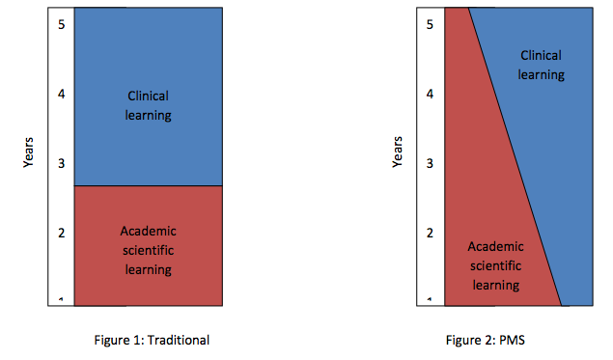
Peninsula Medical School course structure

Slide 24
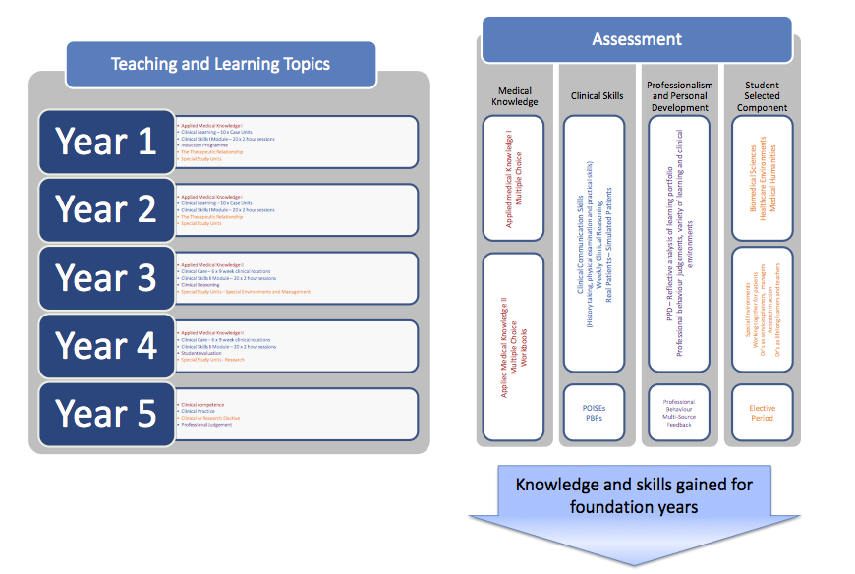
Peninsula Medical School: teaching & assessment

Slide 25
Peninsula Medical School: key features include …
Use of the spiral curriculum.
Progress tests and portfolio assessment.
Final focus on ‘patient presentations’ for assessment.
“In all five years the assessment was designed to address the programme level graduate outcomes.”

Slide 26
Possible discussion questions
Are there any features of this case study which could be useful in your context?
What could be the benefits?
What are the potential issues?
What are the implications for staff workload and student achievement?
Would it work in your context?

Slide 27
Case Study 2:
Coventry Business Management
Each year will have a unifying theme, focussing on a different sector exemplified by a local employer with a global reach or brand – 1st Year Cadburys/Kraft, 2nd Year Jaguar, 3rd Year Barclays.
Second semester of each year, 50% assessment will be through a large integrative task, which will be designed to assess learning from all three modules.
50% of each module will be independently assessed, but other 50% will come from the assessment of the integrated task against different criteria appropriate to each module’s different learning outcomes.

Slide 28
Possible discussion questions
Are there any features of this case study which could be useful in your context?
What could be the benefits?
What are the potential issues?
What are the implications for staff workload and student achievement?
Would it work in your context?

Slide 29
Case Study 2:
New regulations at Brunel
2009 Senate Regulations give almost total freedom in the design of Levels.
Allows conventional modules (modular blocks) = study and assessment credit coterminous.
Allows separate assessment blocks and study blocks.
Study blocks = purely formative, no summative assessment. Study blocks can be any volume of study credits.
Assessment blocks can summatively assess learning from more than one study block. Assessment blocks can be 5 - 40 credits.
Each UG level = 120 study credits + 120 assess credits.
Study credits = expected student study time.
Assessment credits (no time) but reflect complexity and importance.
Encourages Level-based design of study and assessment, as opposed to a module-based approach.

Slide 30
Examples from Brunel
Biomedical Sciences
  Study and assessment blocks in all years.
  Cut assessment load by 2/3rds generated more time for class contact.
  Synoptic exam in all three years.
Mathematics
  Conventional modules in final year only.
  Improved understanding and ‘carry-over’ of ‘the basics’ into year 2.

Slide 31
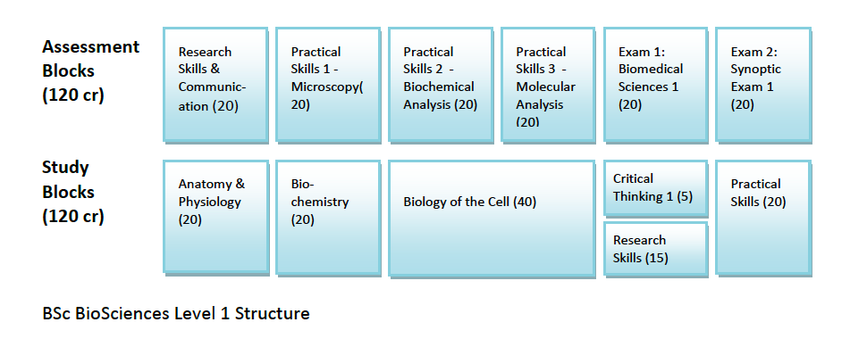
Flexible regulations allow new structures

Slide 32
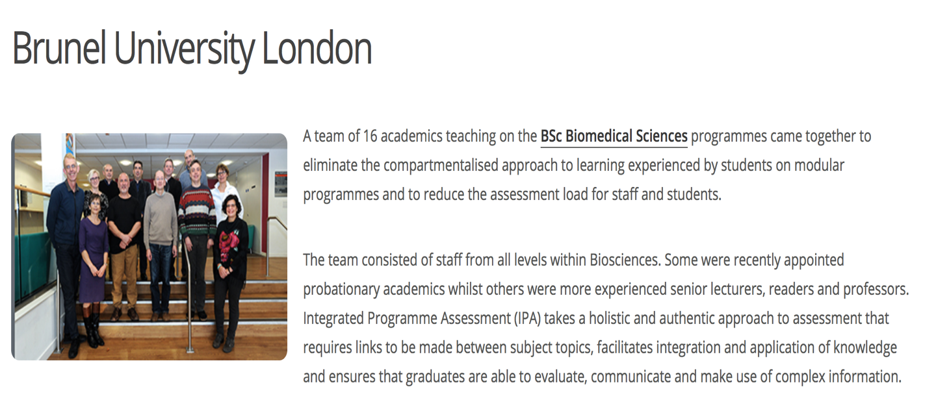
Biomedical Sciences win CATE 2016

Slide 33
Possible discussion questions
Are there any features of this case study which could be useful in your context?
What could be the benefits?
What are the potential issues?
What are the implications for staff workload and student achievement?
Would it work in your context?

Slide 34
Case Study 4:
Pharmacy et al at Bradford
Introduced elements of PFA into the new Mpharm
Benefits:
  Reduction in assessment burden.
  Truly assesses programme outcomes.
  Also introduced Team-based learning (TBL) which motivates and incentivises preparation through assessment for learning.

Slide 35

Team-based learning at Bradford
https://www.bradford.ac.uk/life-sciences/pharmacy-medical-sciences/courses/team-based-learning/

Slide 36
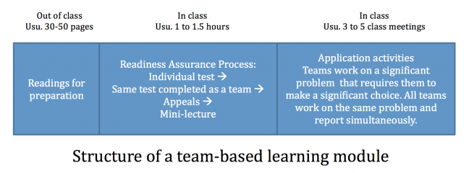
Team-based-learning: Essential features
https://cft.vanderbilt.edu/guides-sub-pages/team-based-learning/

Slide 37
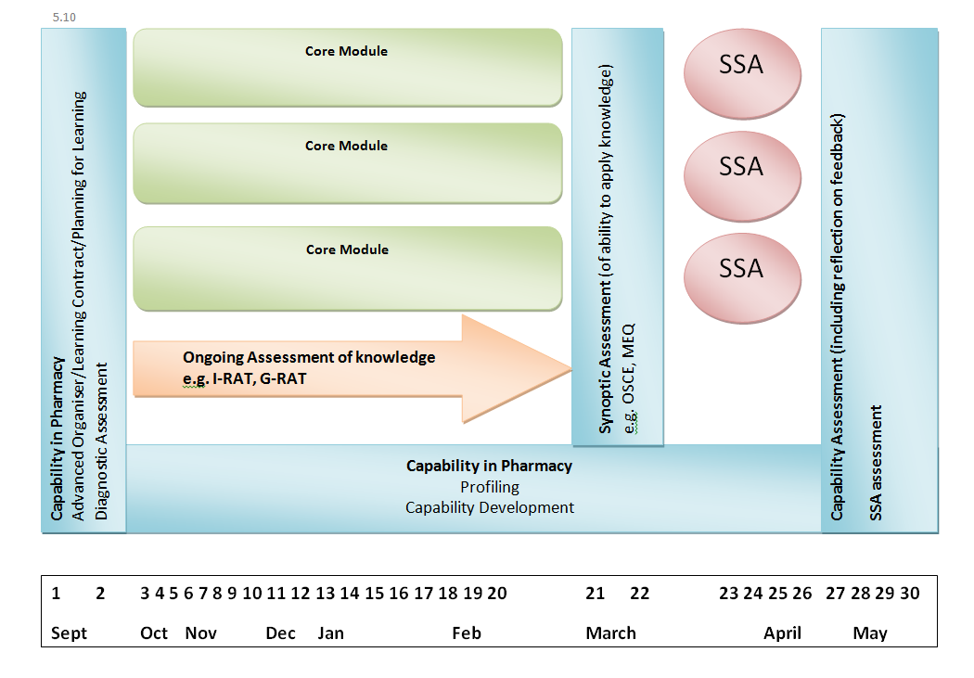

Slide 38


Developing a Long-Loop Assessment using TBL
Alison S Hartley, Josie A Fraser, John R Purvis, Simon J Tweddell
University of Bradford, Bradford, UK
BACKGROUND
Bradford School of Pharmacy adopted TBL as its main instructional strategy for delivering a new MPharm Programme with a spiral curriculum¹ in September 2012.
The core curriculum for Stage 1 of the programme is assessed in March each year, allowing time in April and May for completing student selected assignments.
Stage 2 commences in September and builds on Stage 1 and requires students to reactivate the concepts learned the previous year. The time gap of 6-months was a concern for faculty.
RESULTS
The assessment was perceived as a success by faculty and students.
The discussions taking place in the tRAT clearly demonstrated that the assessment had served the purpose of engaging students in stage 1 concepts that were most relevant to stage 2.
There was clear evidence of peer learning as faculty witnessed team members explaining some of the more difficult concepts to their team members.
STUDENT FEEDBACK
REFLECTIONS
Staff want to continue the long loop - though acknowledge it is time consuming
Staff want to improve the paper and provide students with a list of core concepts learned in year 1 to guide their revision during the vacation
Staff want to communicate and explain the purpose of the long loop further – though most students did understand, based on the data collected
Data showed a range of time was spent preparing
Purpose of this assessment was to test our knowledge on the weaker areas that people struggled in, which i think is a good idea
Not fair as we have to sacrifice holiday time revising when no one else does
If you study enough then it's sort of your foundation for things to come. Refreshes your memory. Helps you gain a better understanding
CONCLUSION
The long-loop assessment is a model that could be used in a spiral curriculum to reactivate knowledge from the previous stage.
When delivered using TBL principles, this creates a motivational framework for students to prepare for the test, engage with and learn from their new teams and prepares students for the next stage of the programme.
DESCRIPTION
Stage 1 students revised and revisited Stage 1 concepts in the summer vacation.
In September students sat a 40 question iRAT drawn from questions previously sat in Stage 1, that were important to Stage 2 or that were particularly challenging.
This was followed by a tRAT, where students answered the questions in their new Stage 2 teams.
This long-loop assessment² is summative with marks contributing towards the Stage 2 final synoptic assessment.
It can lead to stress and disapproval as it cuts into the end of the summer holiday but it is a worthwhile assessment that I find is useful.
REFERENCES
Harden, R “What is a spiral curriculum?” Medical Teacher, 1999, 21:2, 141.
Effective Learning and Teaching in Medical, Dental & Veterinary Education, Ed: Huttly, S., Sweet, J., Taylor, I. 2003, Times Higher Educational Supplement.

Slide 39
MPharm at Bradford: general challenges
Initial lack of understanding of how it could work and what could be achieved through PFA.
Overcoming module obsession.
Overcoming regulations and systems.
Time to plan, explain and develop staff.
Reassessment challenges.
Large programme – over 50 teaching staff.

Slide 40

Pharmacy Curriculum Team win CATE 2017

Slide 41
Possible discussion questions
Are there any features of this case study which could be useful in your context?
What could be the benefits?
What are the potential issues?
What are the implications for staff workload and student achievement?
Would it work in your context?

Slide 42
Review #1: General reflections on PFA
Benefits both staff and students.
Needs cohesive course team.
Needs management support.
Needs a flexible approach to suit the course.
Not a ‘quick fix’.
And you cannot just change assessment:
  Implications for teaching/delivery.
  Implications for regulatory framework.

Slide 43
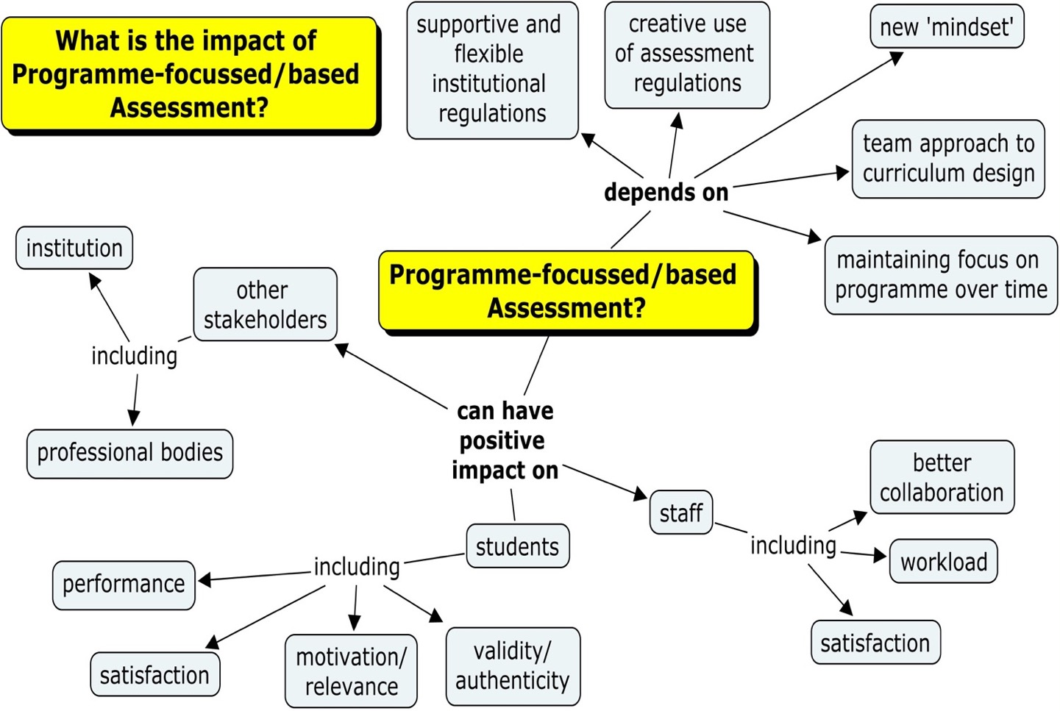
Review #2

Slide 44
Review #3 Follow-up survey – 2016
Some representative comments.
How useful was the PASS project?
The network created access to a wealth of information, ideas and development opportunities. It was wonderful to be part of a community of educators.

Slide 45
What was the long-term impact of using PFA?
A slight improvement in student performance.
Strong cohort identity
100% student satisfaction!
Employer (Flybe Group PLC) reported improved performance from students in the workplace Final assessment (problem-based inquiry into workplace issue) added value for organisation Positive perception of programme among wider workforce (relevant / impactful)
An unexpected long-term impact of programme focused assessment was the facilitation of conversations between staff in designing assessments (which had previously not happened to the same extent). Better prepares students for life long learning, passing of healthcare professional external assessments (which are similar).
Staff in the department are confident that the stage-based assessments are part of helping our students to integrate their knowledge. However, as the new assessments were initiated at the same time as a new teaching / learning strategy, it's not clear to us how much of the change is due to one vs the other.

Slide 46
What advice have you for anyone starting out on PFA?
Be clear on the goals/aims of your programme overall, and each stage of your programme and work back from there to a sensible assessment that does what you want academically, then talk to your administrators, not just academics!
Use half day or day long sessions with whole programme teams to map student and staff activities and experiences and use PASS guidelines to foster a holistic
Work with colleagues in Academic Quality Units early and regularly throughout the programme design, development and implementation stages to consider all aspects of the assessment processes. Explain clearly, and repeatedly, to students (and staff) the rationale for the choices of assessment, focusing on preparing for future. Be prepared to raise challenges to institutional regulations/process barriers which could impede the implementation of such a strategy.
Get staff buy in first!
Think about how you can change student behaviour and if this is feasible.
Try it out. Give it a few years to perfect the assessments. Involve students too.

Slide 47

Review #4 Current developments?
Increasing interest in programme assessment.
Revised PASS website.
Several HEIs making policy commitments,
eg Sheffield
https://www.sheffield.ac.uk/lets/cpd/conf/2018/intro

Slide 48
Selected References
Whitfield R. & Hartley P. (2018) Assessment challenges for programme leaders – making the move to programme-focussed assessment in Lawrence J. & Ellis S. (eds) Supporting programme leaders and programme leadership, SEDA Special 39.
Whitfield R. & Hartley P. (2017) Whatever happened to Programme Assessment Strategies? SEDA Educational Developments 18.1 ISSN 1469-3267
Hartley P. & Whitfield R. (2011) The case for Programme-Focused Assessment, SEDA Educational Developments Issue 12.4 ISSN 1469-3267

Slide 49
And finally …
These and other case studies and examples are available on the PASS website:
https://www.Bradford.ac.uk/pass/
Further examples, updates and resources will be added to the website as they become available.

Slide 50
Acknowledgements
The original workshop presentation was developed by Chris Rust, Oxford Brookes University for the PASS project with input from Peter Hartley and Ruth Whitfield, University of Bradford.
This updated was revised (2018) by Ruth Whitfield, University of Bradford, and Peter Hartley, Consultant (profpeter1@me.com)
To contact the PASS project please email Ruth Whitfield r.whitfield@Bradford.ac.uk
For the lastest news, follow us on Twitter @PASS_Bradford

